Slide 1
Recap: Critical points of a vdw gas
The critical state (e.g., $T_{crit}$, $V_{crit}$, and $P_{crit}$) can be derived for a vdw gas by noticing that it’s an inflection point:
${\left(\frac{∂P}{∂V}\right)}_{T}=0$ and ${\left(\frac{∂^{2}P}{∂V^{2}}\right)}_{T}=0$
The results are
$$T_{crit}=\frac{8}{27}\frac{a}{Rb}≈\frac{1}{3}\frac{a}{Rb}$$
$$V_{crit}=n3b$$
$$P_{crit}=\frac{a}{27b^{2}}$$

Slide 2
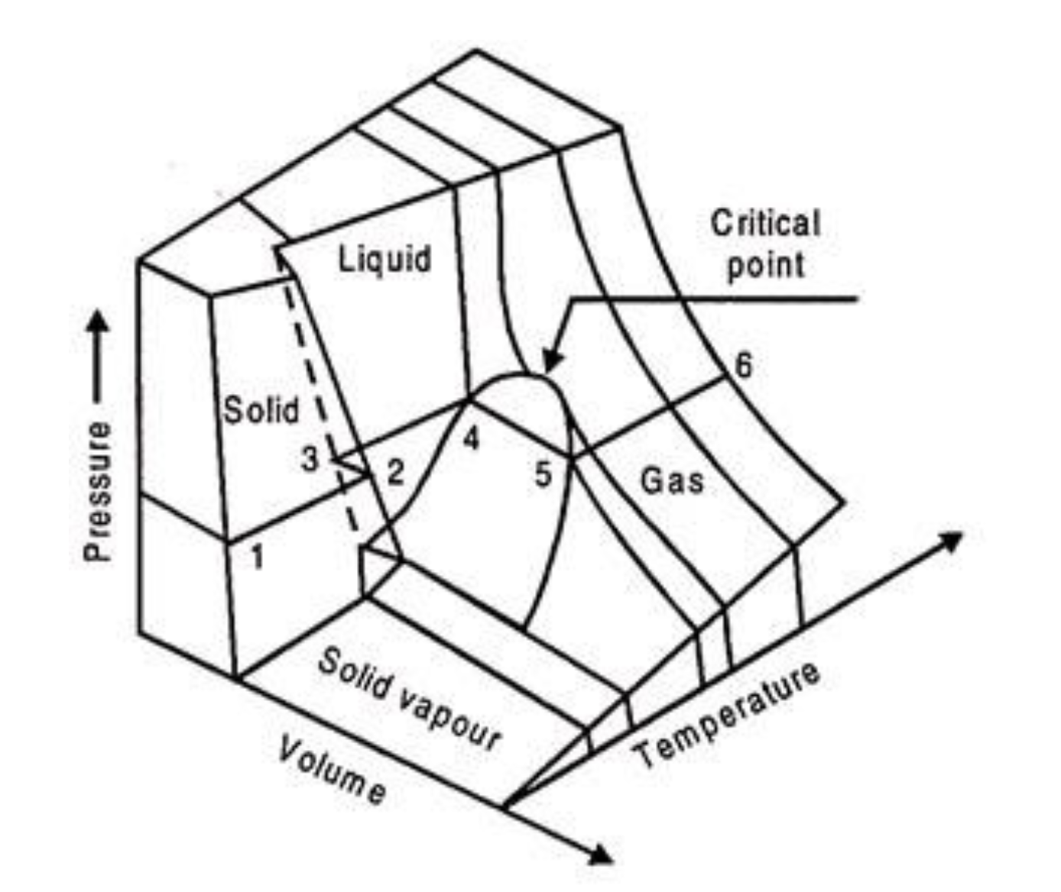
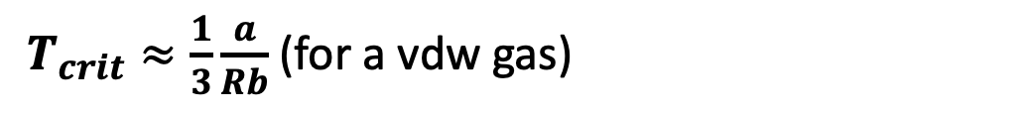
Here’s $T_{crit}$ in our “corresponding states” diagram
$T_{crit}≈\frac{1}{3}\frac{a}{Rb}$ (for a vdw gas)
https://www.engineeringenotes.com/thermal-engineering/real-gases/real-gases-properties-van-der-waals-equation-and-equation-of-state-thermal-engineering/49112

Slide 3
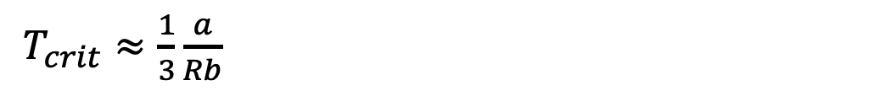
For reference … $T_{crit}<T_{Boyle}$ (if you remember: $T_{Boyle}=\frac{a}{Rb}$)
$T_{Boyle}≈\frac{a}{Rb}$
$T_{crit}≈\frac{1}{3}\frac{a}{Rb}$
https://www.engineeringenotes.com/thermal-engineering/real-gases/real-gases-properties-van-der-waals-equation-and-equation-of-state-thermal-engineering/49112

Slide 4
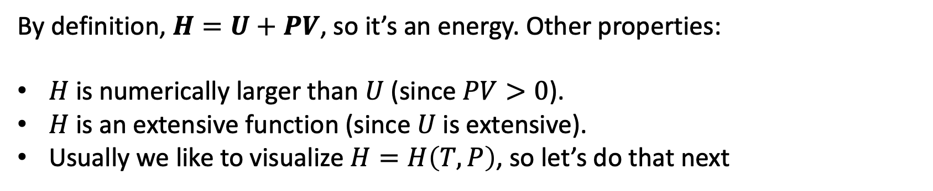
Introducing the Enthalpy, $H$
By definition, $H=U+PV$, so it’s an energy. Other properties:
$H$ is numerically larger than $U$ (since $PV>0$).
$H$ is an extensive function (since $U$ is extensive).
Usually we like to visualize $H=H\left(T,P\right)$, so let’s do that next

Slide 5
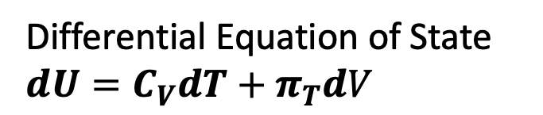
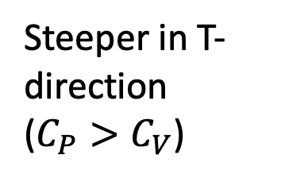
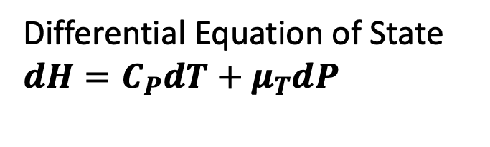
Slopes of $H\left(T,P\right)$ compared to $U\left(T,V\right)$
Differential Equation of State
$$dU=C_{V}dT+π_{T}dV$$
Differential Equation of State
$$dH=C_{P}dT+μ_{T}dP$$
U(T,V)
H(T,P)
Steeper in T-direction ($C_{P}>C_{V}$)
V
P
T
T
T-V state space
T-P state space

Slide 6

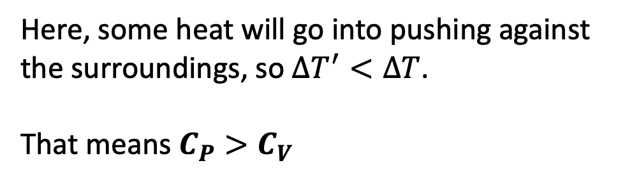
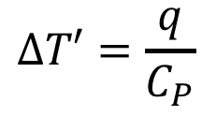
Why $C_{P}>C_{V}$ … the physical argument
w
q
$$∆T=\frac{q}{C_{V}}$$
q
$$∆T′=\frac{q}{C_{P}}$$
Here, some heat will go into pushing against the surroundings, so $∆T^{′}<∆T$.
That means $C_{P}>C_{V}$

Slide 7
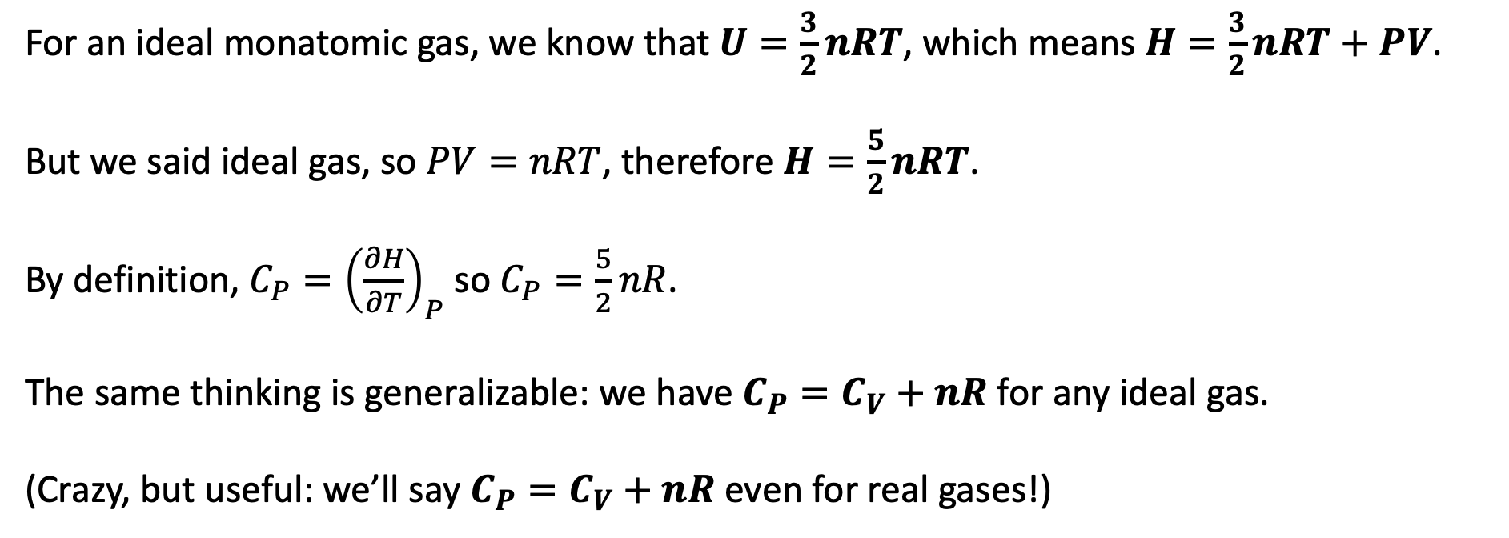
Why $C_{P}>C_{V}$ … the mathematical argument
For an ideal monatomic gas, we know that $U=\frac{3}{2}nRT$, which means $H=\frac{3}{2}nRT+PV$.
But we said ideal gas, so $PV=nRT$, therefore $H=\frac{5}{2}nRT$.
By definition, ${C_{P}=\left(\frac{∂H}{∂T}\right)}_{P}$ so $C_{P}=\frac{5}{2}nR$.
The same thinking is generalizable: we have $C_{P}=C_{V}+nR$ for any ideal gas.
(Crazy, but useful: we’ll say $C_{P}=C_{V}+nR$ even for real gases!)

Slide 8
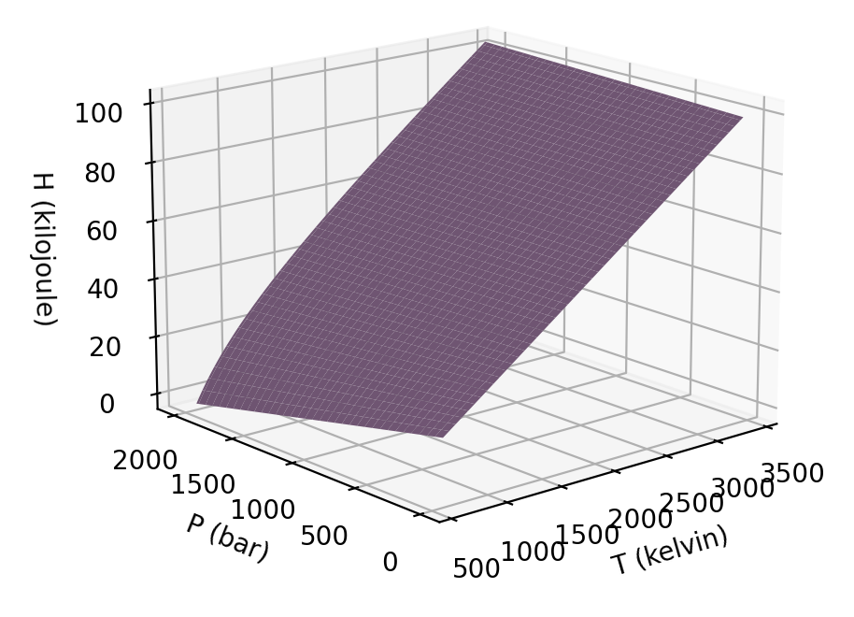
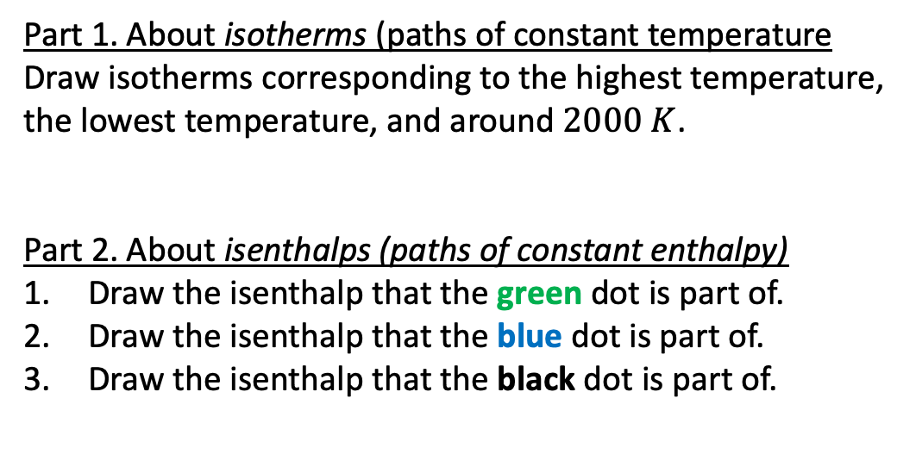
In-class exercise about isotherms and isenthalps of $H(T,P)$
Part 1. About isotherms (paths of constant temperature
Draw isotherms corresponding to the highest temperature, the lowest temperature, and around $2000 K$.
Part 2. About isenthalps (paths of constant enthalpy)
Draw the isenthalp that the green dot is part of.
Draw the isenthalp that the blue dot is part of.
Draw the isenthalp that the black dot is part of.

Slide 9
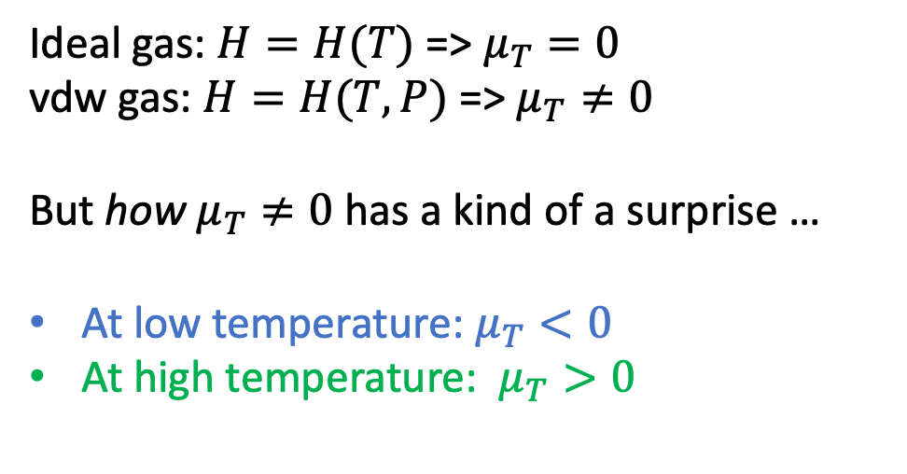


The temperature dependence of $μ_{T}$
$$μ_{T}>0$$
Ideal gas: $H=H(T)$ => $μ_{T}=0$
vdw gas: $H=H(T,P)$ => $μ_{T}≠0$
But how $μ_{T}≠0$ has a kind of a surprise …
At low temperature: $μ_{T}<0$
At high temperature: $μ_{T}>0$
$$μ_{T}<0$$

Slide 10
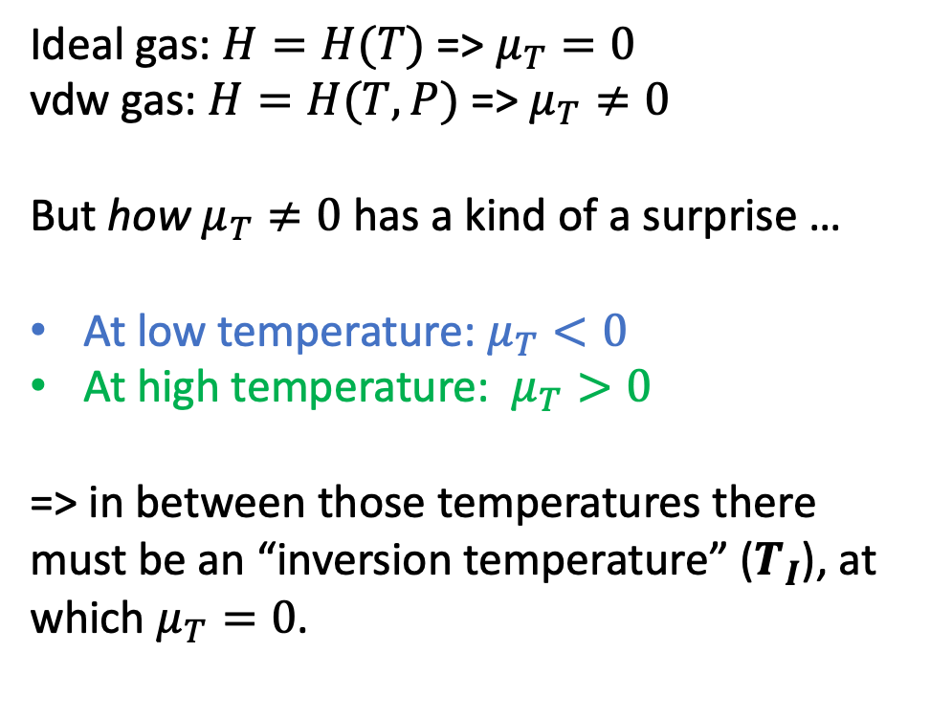
The inversion temperature
$$μ_{T}>0$$
Ideal gas: $H=H(T)$ => $μ_{T}=0$
vdw gas: $H=H(T,P)$ => $μ_{T}≠0$
But how $μ_{T}≠0$ has a kind of a surprise …
At low temperature: $μ_{T}<0$
At high temperature: $μ_{T}>0$
=> in between those temperatures there must be an “inversion temperature” ($T_{I}$), at which $μ_{T}=0$.
$$μ_{T}<0$$

Slide 11
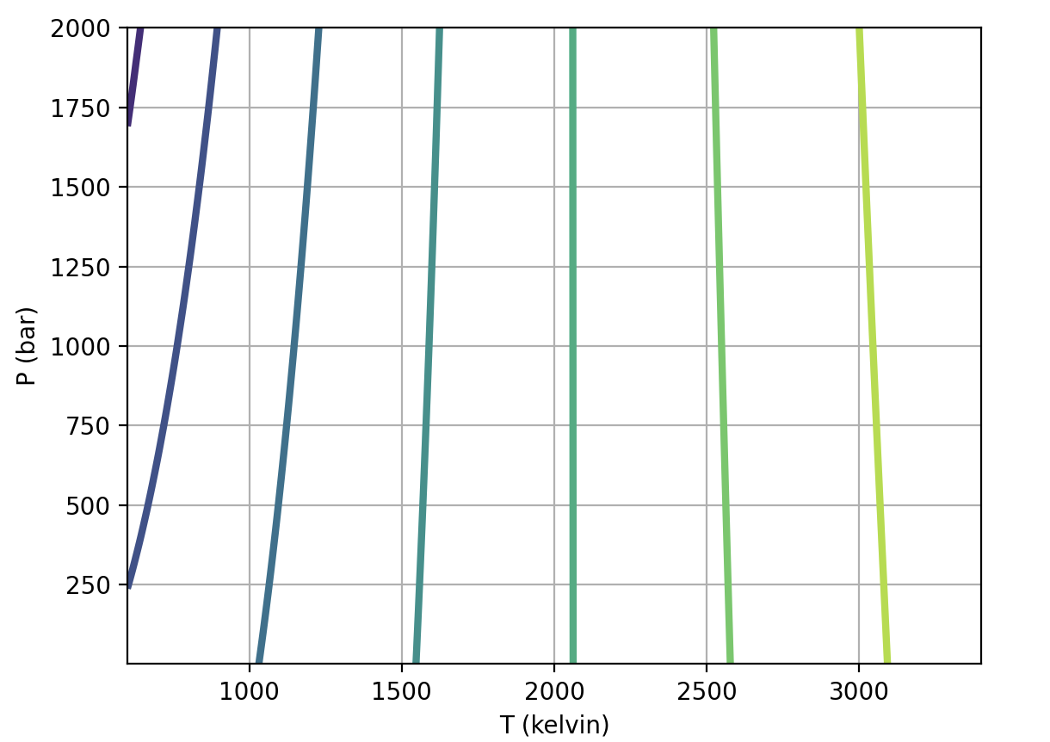
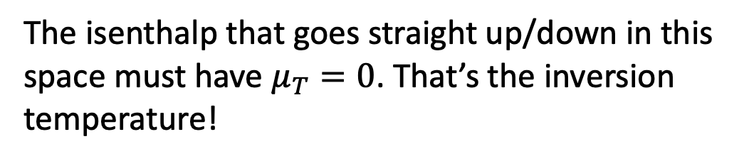
We can identify the inversion temperature by looking at isenthalps (contours) of $H$
The isenthalp that goes straight up/down in this space must have $μ_{T}=0$. That’s the inversion temperature!

Slide 12
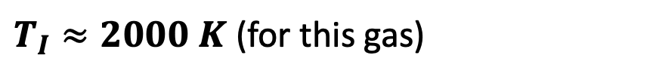
We can identify the inversion temperature by looking at isenthalps (contours) of $H$
$T_{I}≈2000 K$ (for this gas)
The isenthalp that goes straight up/down in this space must have $μ_{T}=0$. That’s the inversion temperature!

Slide 13
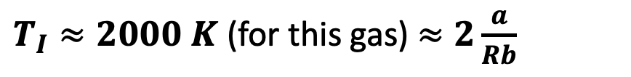
We can also predict the inversion temperature from vdw parameters (a job for Thursday)
$T_{I}≈2000 K$ (for this gas) $≈2\frac{a}{Rb}$
The isenthalp that goes straight up/down in this space must have $μ_{T}=0$. That’s the inversion temperature!

Slide 14
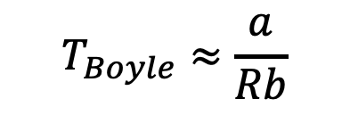

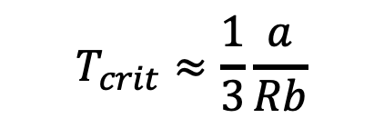
For reference ... $T_{crit}<T_{Boyle}<T_{I}$
$$T_{I}≈2\frac{a}{Rb}$$
$$T_{Boyle}≈\frac{a}{Rb}$$
$$T_{crit}≈\frac{1}{3}\frac{a}{Rb}$$
https://www.engineeringenotes.com/thermal-engineering/real-gases/real-gases-properties-van-der-waals-equation-and-equation-of-state-thermal-engineering/49112

Slide 15
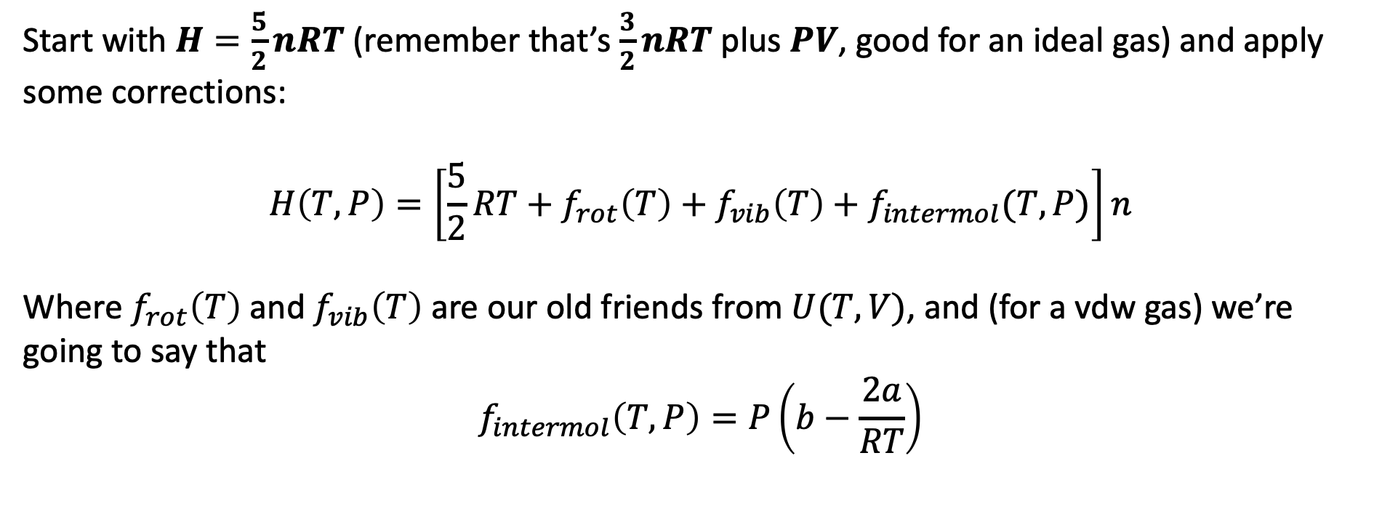
An approximation for the Enthalpy of a vdw gas
Start with $H=\frac{5}{2}nRT$ (remember that’s $\frac{3}{2}nRT$ plus $PV$, good for an ideal gas) and apply some corrections:
$$H\left(T,P\right)=\left[\frac{5}{2}RT+f_{rot}\left(T\right)+f_{vib}\left(T\right)+f_{intermol}(T,P)\right]n$$
Where $f_{rot}\left(T\right)$ and $f_{vib}\left(T\right)$ are our old friends from $U(T,V)$, and (for a vdw gas) we’re going to say that
$$f_{intermol}\left(T,P\right)=P\left(b−\frac{2a}{RT}\right)$$

